Slide 1
Server-side Web Development
Servlets

Slide 2
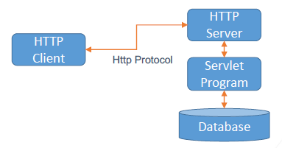
Servlets – What are they?
Servlets are programs that run on a Web or App. server
They act as a middle layer between a requests coming from a Web browser or other HTTP client and databases or other applications on the HTTP server.
Servlets are implemented in Java.
The specification is available from
https://download.oracle.com/otndocs/jcp/servlet-3.0-fr-oth-JSpec/

Slide 3
Servlets - Advantages
Performance – Java servlets are compiled java code
Servlets execute within the address space of a Web server. Typically servlets run as threads created by the Web Server.
Servlets are platform-independent because they are written in Java.
So servlets are trusted - Java security manager on the server enforces a set of restrictions to protect the resources on a server machine.
The full functionality of the Java class libraries is available to a servlet.

Slide 4
Servlets - Responsibilities
Read the explicit data sent by the clients (browsers). This includes an HTML form on a Web page a custom HTTP client program.
Read the implicit HTTP request data sent by the clients (browsers). This includes cookies, media types and compression schemes the browser understands, and so forth. (i.e. HTTP Header information)
Process the data and generate the results. This process may require talking to a database, executing an RMI call, invoking a Web service, or computing the response directly.

Slide 5
Servlets – Responsibilities Continued
Send the explicit data (i.e., the document) to the clients (browsers). This document can be sent in a variety of formats, including text (HTML or XML), binary (GIF images), Excel, etc.
Send the implicit HTTP response to the clients (browsers). This includes telling the browsers or other clients what type of document is being returned (e.g., HTML), setting cookies and caching parameters, and other such tasks (i.e. HTTP Header information)

Slide 6
Servlets - Packages
Java Servlets are Java classes run by a web server that has an interpreter that supports the Java Servlet spec.
Servlets can be created using classes and interfaces from the javax.servlet and javax.servlet.http packages, which are a standard part of the Java’s Enterprise Edition
These classes implement the Java Servlet and JSP specifications.
Java servlets have been created and compiled just like any other Java class. As long as the libraries are on your CLASSPATH, you can compile servlets with the JDK's Java compiler or any other current compiler.

Slide 7
Servlets - Lifecycle
The servlet is initialized by calling the init() method.
The servlet calls service() method to process a client's request.
The service method will call appropriate doGet, doPost etc. depending on request HTTP Method.
The servlet is terminated by calling the destroy() method.
Finally, servlet is garbage collected by the garbage collector of the JVM.

Slide 8
Servlets – init() method
When a user invokes a servlet, a single instance of each servlet gets created, with each user request resulting in a new thread that is handed off to doGet or doPost as appropriate.
The servlet is normally created when a user first invokes a URL corresponding to the servlet.
You can also specify that the servlet be loaded when the server is first started.
The init() method simply creates or loads some data that will be used throughout the life of the servlet.

Slide 9
Servlets – service() method
The servlet container (i.e. web server) calls the service() method to handle requests coming from the client( browsers) and to write the formatted response back to the client.
Each time the server receives a request for a servlet, the server spawns a new thread and calls service().
The service() method checks the HTTP request type (GET, POST, PUT, DELETE, etc.) and calls doGet, doPost, doPut, doDelete, etc. methods as appropriate.

Slide 10
Servlets – destroy() method
The destroy() method is called only once at the end of the life cycle of a servlet. This method gives your servlet a chance to cleanup; i.e. close database connections, halt background threads, write cookie lists or hit counts to disk etc.
After the destroy() method is called, the servlet object is marked for garbage collection.

Slide 11
Servlets – Lifecycle Architecture
1. HTTP requests coming to the server are delegated to the servlet container.
2. The servlet container loads the servlet and calls the init() method.
3. Then the servlet container handles multiple requests by spawning multiple threads, each thread executing the service() method of a single instance of the servlet.
4. When servlet finished destroy() is called to clean-up and garbage collect the servlet.

Slide 12
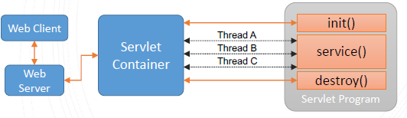
Servlets – Lifecycle Architecture

Slide 13
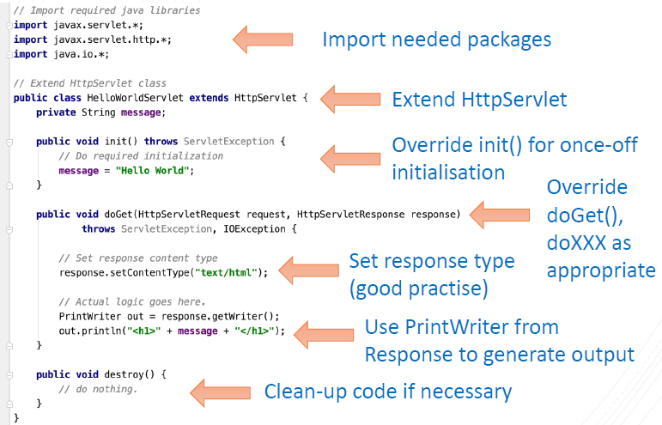
Servlets - Example

Slide 14
Servlets - Deployment
By default, a servlet application is located at the path
<Tomcat-InstallDir>/webapps/ROOT
and the class file would reside in
<Tomcat-InstallDir>/webapps/ROOT/WEB-INF/classes.
If you have a fully qualified class name of com.myorg.MyServlet, then this servlet class must be located in
WEB-INF/classes/com/myorg/MyServlet.class

Slide 15
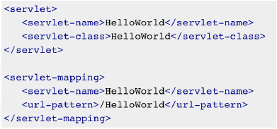
Servlets - Deployment
Traditionally information on the servlet name, servlet class and URL mapping would have been contained in the web.xml file inside directory
<Tomcat-InstallDir>/webapps/ROOT/WEB-INF/

Slide 16
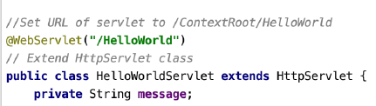
Servlets - Deployment
Luckily we can now use Annotations to provide the same URL Mapping information
@WebServlet(url) can be used to set the url path
This associates the URL http://localhost:8080/ContextRoot/HelloWorld
with the HelloWorldServlet class.

Slide 17

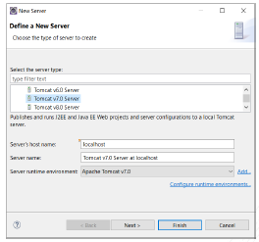
Servlets – Configuring our Server
Open Servers section at bottom
Select “Click this link to create new server”
3. Select Apache Tomcat 7 (version in XAMPP)
4. Select Add

Slide 18
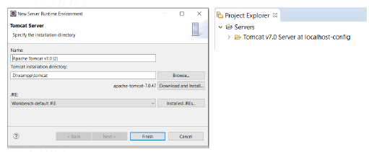
Servlets – Configuring out Server
1. Browse to the tomcat directory under XAMPP install
2. Select Finish
3. New Server should appear in Project Explorer

Slide 19
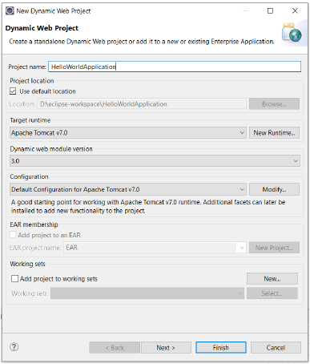
Servlets – Writing our First Servlet
Make sure we are using J2EE
version of Eclipse (or have J2EE
extensions installed)
Switch to the J2EE perspective
File -> New -> Dynamic Web Project
Give it a project name
Select Target Runtime to match
server version

Slide 20
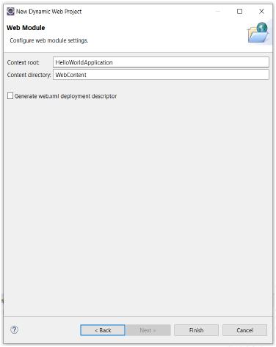
Writing our First Servlets
6. Select next and next again
7. Leave ‘Generate
web.xml deployment
descriptor’ unchecked
8. Change the Context Root
if you want (defaults to
project name)
9. Select Finish

Slide 21
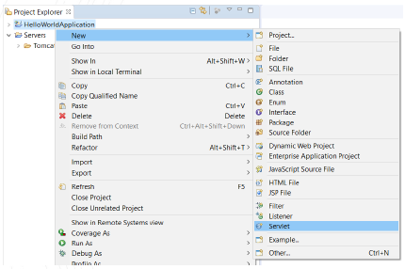
Servlets – Writing our First Server
10. Right click on Web Application -> New -> Servlet

Slide 22
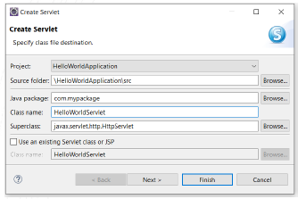
Servlets – Writing our First Server
11. Right click on Web Application -> New -> Servlet
12. Enter Java package and Class name information
13. Click Next

Slide 23
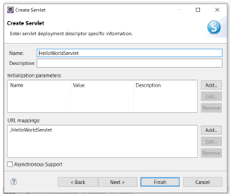
Servlets – Writing our First Servlet
14. Enter Description
if wanted
15. Edit the URL
Mapping if
wanted (or leave
and we can edit
this with an
annotation later)
16. Click Next

Slide 24
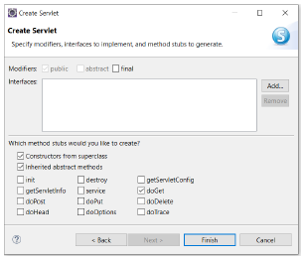
Servlets – Writing our First Servlet
17. Select which
methods of the base
servlet class you
want to override,
e.g. doGet
18. Click Finish

Slide 25
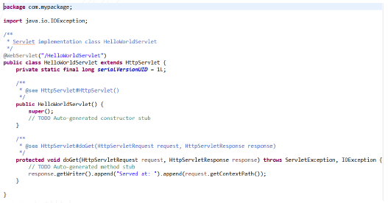
Servlets – Writing our First Servlet

Slide 26

Servlets – Running our Servlet
1. Right Click -> Run AS -> Run on Server
2. Select Apache Tomcat 7 at localhost
3. It should start the server (see console output) and open a new browser tab
4. This sends a GET request to the Server.
5. Our servlet code in doGet is run and Served
at:/HelloWorldApplication is printed to screen.

Slide 27
Servlets – Examining our Servlet
http://localhost:8080/HelloWorldApplication/HelloWorldServlet
HelloWorldApplication is known as the “Context root”.
It allows more than one Web Application to be deployed to the same Web Server.
In Eclipse, by default it is set to the name of the project.
If you copy a project, the context root will not be changed.
Right Click -> properties -> Web Project Settings to change the
Context root.

Slide 28
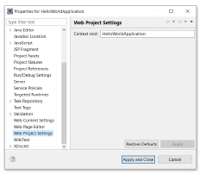
Servlets – Examining our Servlet

Slide 29
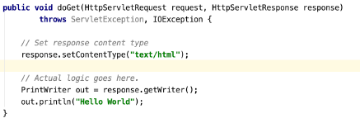
Servlets – Writing our First Servlet
Change the code in the doGet method to something more traditional and rerun on the server.

Slide 30
HTML Forms with Servlets
As we already know FORM data is packaged into a “form data set”
This consists of a sequence of name/value pairs
When the submit button is pressed, the form data set is sent to the Web Server. For example
name=martina&email=mcurran@ait.ie&telNumber=0871234567&message=Some message typed in by the user
Contains HTTP request parameters. Either appended to URL (for a GET) or in the body of the HTTP message (POST).

Slide 31
HTML Forms with Servlets
Create a new Dynamic Web Application called HelloForms following same method as before
Create a new servlet called HelloFormsServlet
Select the doPost method to override this time.
Next we’ll create a new index.jsp page in the WebContent folder of our HelloForms project
This will contain our HTML form that will then call our servlet on submission

Slide 32
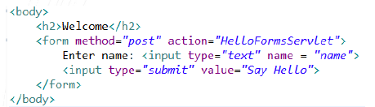
HTML Forms with Servlets
Paste the following HTML code into the index.jsp page
Here it is a standard HTML FORM with a method of POST and the action set to the name of our servlet. i.e. HelloFormServlet

Slide 33
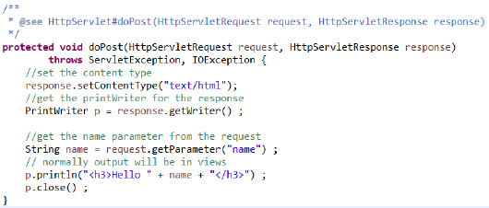
HTML Forms with Servlets
Update the HelloFormsServlet doPost method to look something like

Slide 34
HTML Forms with Servlets
Notice that data is submitted from a FORM using a POST.
The Servlet now implements a method called doPost()
The class HttpServletRequest has a method called getParameter(String name)
This gives access to any HTTP request parameters sent with the request, regardless of whether they are sent via URL with a GET or in the HTTP body via a POST

Slide 35
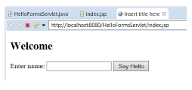
HTML Forms with Servlets
Right Click the index.jsp file and select -> Run -> Run on Server
This time a browser tab will open with our HTML form.
Enter your name and press ‘Say Hello’

Slide 36
Servlets - Exercise
Write a JSP page (index.jsp) containing a FORM.
The FORM should have
A textfield to enter a name
A textfield to enter an address
Write a servlet to process this form which returns a message such as
Hello Paul from Athlone
Run on server as normal to check it works
Set a breakpoint in the doPost method
This time Debug on Server and step through.

